Slide 1
Heart Disease Prediction
using ANN Model
2410030248-Swathi
2410030245-vishnuchethana
2410030249-Nikhila
2410030379-Caesar

Slide 2

INTRODUCTION
Heart disease is one of the leading causes of death worldwide. According to the World Health Organization, early detection can save many lives.
This project uses machine learning techniques to predict heart disease based on patient medical parameters. It helps doctors in early diagnosis and supports better clinical decision-making.

Slide 3
Objectives
Analyze heart disease dataset
Preprocess data for ANN
Design & implement ANN model
Train using backpropagation
Evaluate using Accuracy, Confusion Matrix, ROC & AUC
Visualize model performance using graphs

Slide 4
Dataset Overview
Total Rows: 1025
Total Columns: 14
Data Type:
13 Integer columns
1 Float column (oldpeak)
Target Variable:
0 → No heart disease
1 → Heart disease

Slide 5
Important Feature Insights
👤 Age
Min: 29
Max: 77
Mean: 54
❤️ Cholesterol (chol)
Mean: 246
Max: 564 (very high outlier present)
💓 Max Heart Rate (thalach)
Mean: 149
Range: 71 – 202
📉 Oldpeak (ST depression)
Mean: 1.07
Max: 6.2

Slide 6
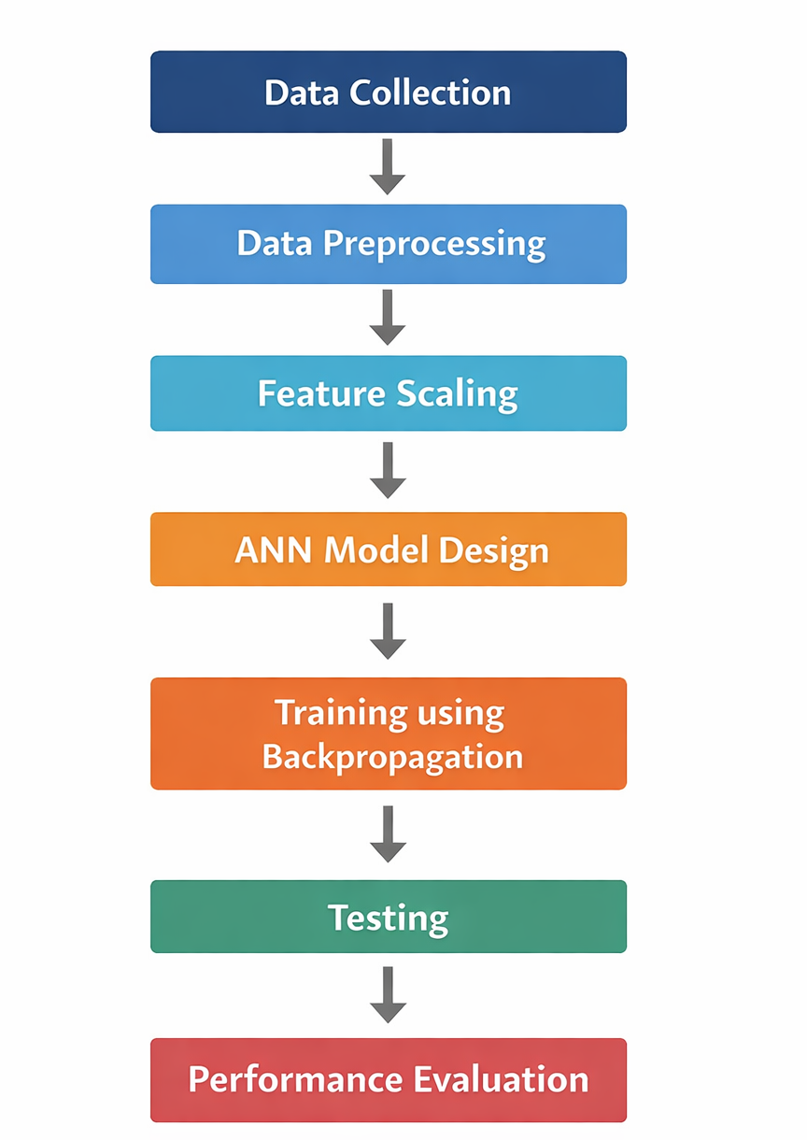
System Architecture

Slide 7
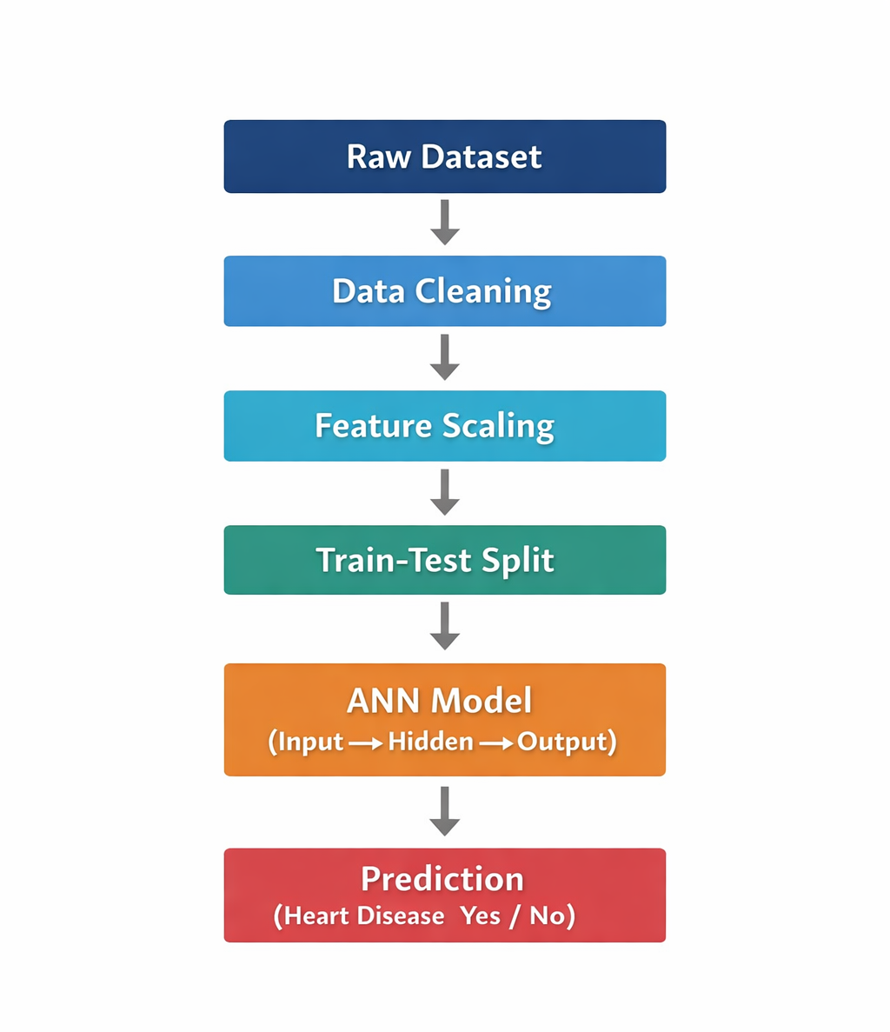
Methodology

Slide 8
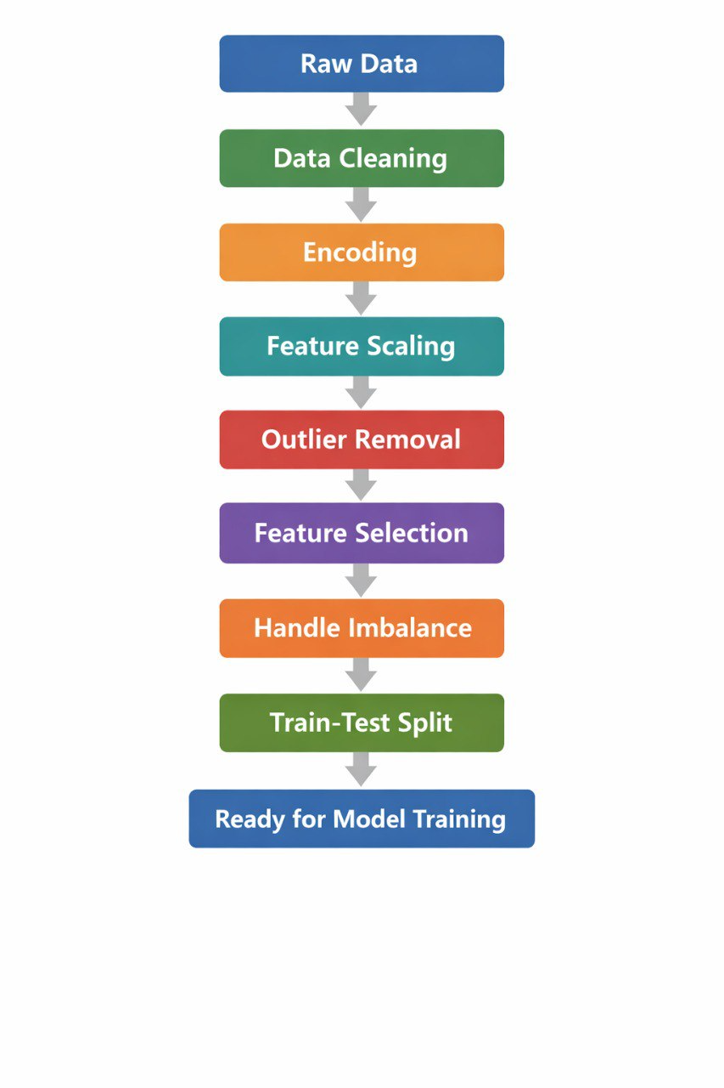
PRE PROCESSING STEPS

Slide 9
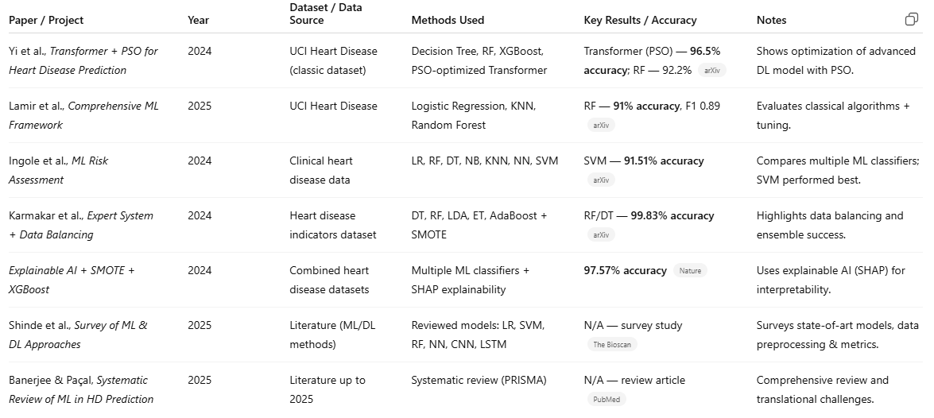
LITERATURE SURVEY

Slide 10
Literature Survey – Gap Analysis
Some models achieve very high accuracy (96–99%)
Use advanced DL or heavy optimization → high computational cost
Many rely on classical ML (SVM, XGBoost)
Heavy use of SMOTE → risk of overfitting
Complex architectures, not lightweight
Mostly focus on accuracy, not real-time deployable ANN
Survey papers propose no new model

Slide 11
Identified Research Gaps
Mostly use classical ML (RF, SVM, XGBoost)
Deep models are expensive
Overfitting risk (SMOTE, heavy tuning)
Less focus on simple ANN
No lightweight real-time ANN
Focus on accuracy, not recall

Slide 12
Research Gap and Proposed Solution
Existing models:
Random Forest, SVM, XGBoost
Transformers need high computation
Focus mainly on accuracy, not false negatives
SMOTE may cause overfitting
Proposed:
Lightweight ANN model
Improves recall (reduces false negatives)
Efficient for real-time clinical use

Slide 13
References
[1] Y. Yi et al., “Transformer-Based Model with Particle Swarm Optimization for Heart Disease Prediction,” arXiv preprint, 2024.
[2] M. Lamir et al., “A Comprehensive Machine Learning Framework for Heart Disease Prediction,” 2025.
[3] S. Ingole et al., “Machine Learning-Based Risk Assessment for Heart Disease,” 2024.
[4] A. Karmakar et al., “Expert System with Data Balancing Techniques for Heart Disease Prediction,” 2024.
[5] “Explainable Artificial Intelligence with SMOTE and XGBoost for Heart Disease Prediction,” Nature, 2024.
[6] P. Shinde et al., “Survey of Machine Learning and Deep Learning Approaches for Heart Disease Prediction,” The Bioscan, 2025.
[7] S. Banerjee and R. Pacal, “Systematic Review of Machine Learning Techniques in Heart Disease Prediction,” PubMed Indexed Journal, 2025.
[8] D. Dua and C. Graff, “UCI Machine Learning Repository,” University of California, Irvine, 2019. [Online]. Available: http://archive.ics.uci.edu/ml

